Slide 1
Contact Management System
BY : Muhammad ZafraN bin Muhammad zaly shah
Mohamad amir amirul bin mohd azam

Slide 2
Introduction
We are planning to make a project about contact management system. That phone system because we see that that system can be manipulate easy. In this system we include the sorting, search and stack in case study. We trying to keep things as simple as possible.

Slide 3
Objective
Manage important and vital information they need that exist in their contacts
Make it easy to get information in their contacts
Need minimum time to search information
Make user easy to find the call history.

Slide 4
Use Case
Use Case | Action
Add Contact | Allow user to add contacts
Delete contact | Delete contacts
Call | Call the selected contact
History | Keeps track of the last 10 calls
Search | Search contacts
Sort | Sort contacts according alphabetical order

Slide 5
Assignment 1
BY : Muhammad ZafraN bin Muhammad zaly shah
Mohamad amir amirul bin mohd azam

Slide 6
Attributes and member function
Attributes
Char name
Int phoneNumber
Char email
Member Function
Contact()
Contact(char,int,email)
Void setName(char)
Void SetPhone(int)
Void setEmail(char)
Void getName()
Int getPhone()
Char getemail()

Slide 7
Draw the class diagram
Contact
- Char name - Int phoneNumber - Char email
+ Contact() + Contact(char,int,email) + Void setName(char) + Void SetPhone(int) + Void setEmail(char) + Void getName() + Int getPhone() + Char getemail()

Slide 8
Application of Sorting Algorithm
The system will ask the user to insert as many number of contact he/he once.
After the user finish entering the contact the system will automatically sort the contact according alphabetical order.
Finale the system will print the contact list in a text file and recall of the user want to see in the system.

Slide 9
Application of Searching algorithm
The system will ask the user what they want to search.
Type of search in this system is search which number they want.
The user just need to type number to get how is the owner for that number.

Slide 10
Assignment 2
BY : Muhammad ZafraN bin Muhammad zaly shah
Mohamad amir amirul bin mohd azam

Slide 11
Application of Linked List Data Structure
The system will ask the user to insert as many number of contact he/he once.
After the user finish entering the contact the system will automatically make a list of contact the insert.
And for the finale, the system will save the contact in the data file.
They also can search the history of what they have insert in the system.

Slide 12
Mini Project
BY : Muhammad ZafraN bin Muhammad zaly shah
Mohamad amir amirul bin mohd azam

Slide 13
Application of Stack Algorithm
The system will keep track of the last 10 call that have been made by user.
After 10 call, the system will deleted the first of the 10 call that have been inserted previously.

Slide 14
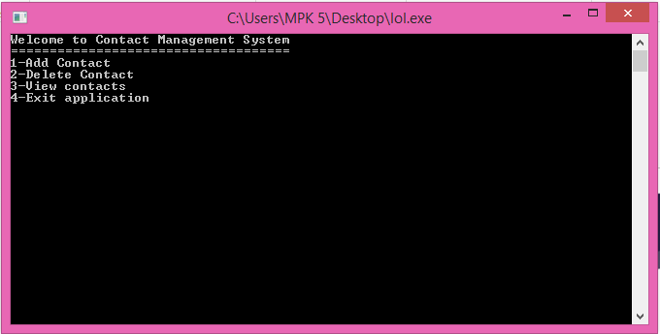
Application System Prototype

Slide 15
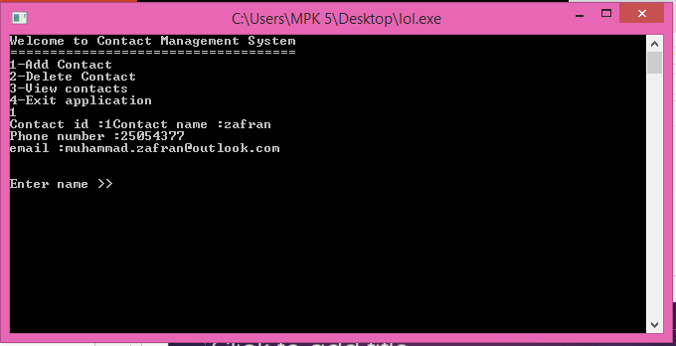
Application System

